Slide 1

Testing Show and Tell

Slide 2

Unit vs Integration vs E2E
Compare Approaches
Not covering TDD (today)
Conversational
TODAY’S AGENDA

Slide 3
Goal
There is no silver bullet
Every option has tradeoffs
Quick feedback and Confidence

Slide 4
Demo App
https://github.com/leantechniques/testing-comparison/

Slide 5
Unit Tests

Slide 6
Unit Test Characteristics
FIRST
Fast
Isolated
Repeatable
Self-validating
Timely

Slide 7
Unit Test Example
in React and Java

Slide 8
Unit Tests Tradeoffs
Pros
Rapid Feedback
Clarifies Design
Deterministic
Test logic in isolation
Find bugs quicker
Less time in the debugger
Cons
Isolation can give less confidence than integration tests
Can be tightly coupled to implementation

Slide 9
Integration Tests

Slide 10
Integration Test Characteristics
Broad category of non-unit tests
Invokes multiple parts of a system together
May have external dependencies
May not all be in memory
Usually less deterministic IF there are uncontrolled dependencies
Also useful for testing legacy code

Slide 11
Integration Test Example
in React and Java

Slide 12
Integration Tests Tradeoffs
Pros
Can give more confidence due to testing more of the system together
Can be less tightly coupled to implementation
Cons
Can be less deterministic than unit tests
Usually slower than unit tests
Can be more maintenance than unit tests
Shared state management

Slide 13
End to End Tests

Slide 14
E2E Test Characteristics
Type of integration test
Invokes a system from the entry point to its end
Will have external dependencies
Will not be in memory
Usually slowest form of integration test
Usually less deterministic IF there are uncontrolled dependencies

Slide 15
End to End Test Example
using React and Java

Slide 16
E2E Tests Tradeoffs
Pros
Can give the most confidence
Usually much less tightly coupled to implementation
Cons
Is less deterministic than unit tests
Much slower than unit tests
Are more maintenance than unit tests

Slide 17
How many of each?

Slide 18
It Depends!

Slide 19
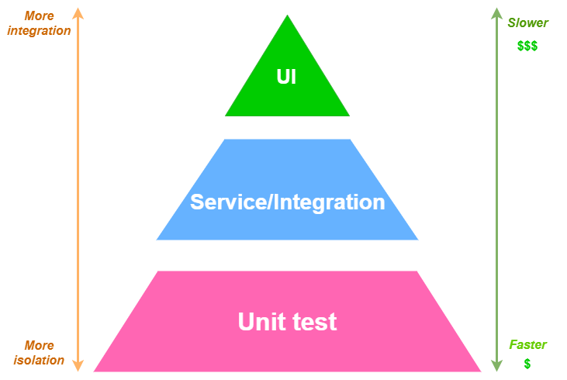
Testing Pyramid

Slide 20
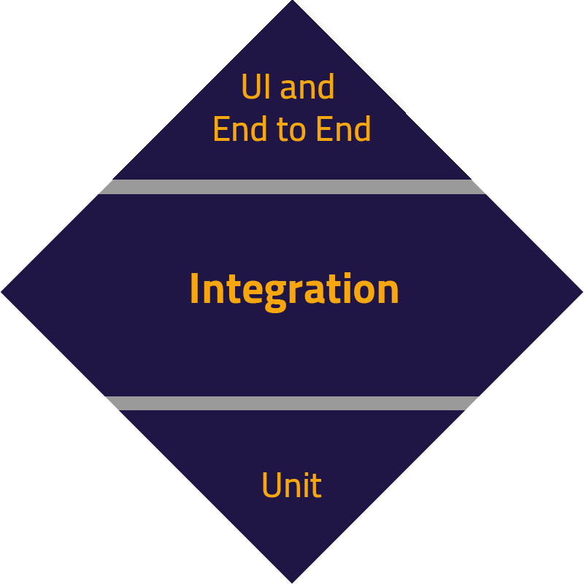
Testing Diamond

Slide 21
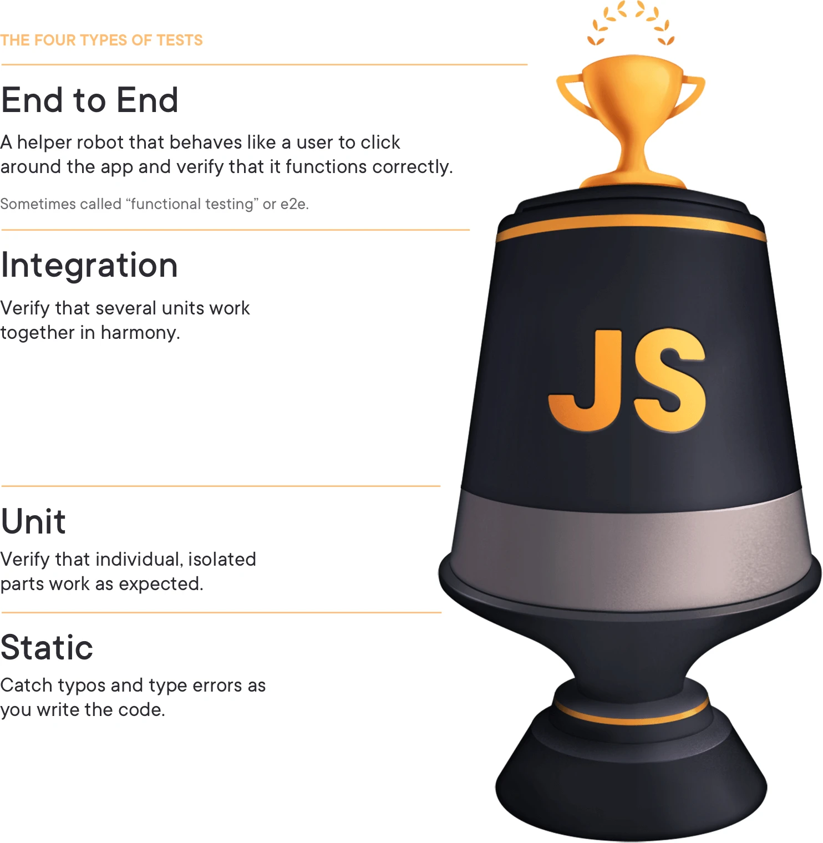
Testing Trophy

Slide 22
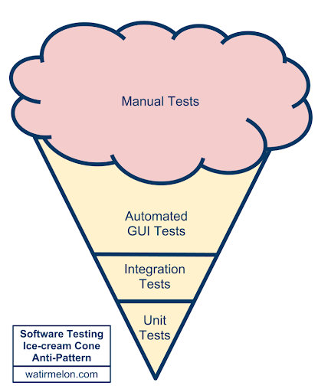
Testing Ice Cream Cone

Slide 23
Summary
Tradeoffs with different approaches
Remember – we want quick feedback and confidence
Which tradeoff you accept is up to you

Slide 24

Discussion

